Slide 1
Spark “group by” deep dive
Part 1
Introduction
Nikolay
Join us in telegram t.me/apache_spark
2020

Slide 2
Example
val ds3 = ds2.groupBy(col("value")).max("value")

Slide 3
Class Dataset method groupBy
/** * Groups the Dataset using the specified columns, so we can run aggregation on them. See * [[RelationalGroupedDataset]] for all the available aggregate functions. * * {{{ * // Compute the average for all numeric columns grouped by department. * ds.groupBy($"department").avg() * * // Compute the max age and average salary, grouped by department and gender. * ds.groupBy($"department", $"gender").agg(Map( * "salary" -> "avg", * "age" -> "max" * )) * }}} * * @group untypedrel * @since 2.0.0 */ @scala.annotation.varargs def groupBy(cols: Column*): RelationalGroupedDataset = { RelationalGroupedDataset(toDF(), cols.map(_.expr), RelationalGroupedDataset.GroupByType) }

Slide 4
Class RelationalGroupedDataset
/** * A set of methods for aggregations on a `DataFrame`, created by [[Dataset#groupBy groupBy]], * [[Dataset#cube cube]] or [[Dataset#rollup rollup]] (and also `pivot`). * * The main method is the `agg` function, which has multiple variants. This class also contains * some first-order statistics such as `mean`, `sum` for convenience. * * @note This class was named `GroupedData` in Spark 1.x. * * @since 2.0.0 */
class RelationalGroupedDataset protected[sql] (
private[sql] val df: DataFrame,
private[sql] val groupingExprs: Seq[Expression],
groupType: RelationalGroupedDataset.GroupType
)

Slide 5
agg method
/** * (Scala-specific) Compute aggregates by specifying a map from column name to * aggregate methods. The resulting `DataFrame` will also contain the grouping columns. * * The available aggregate methods are `avg`, `max`, `min`, `sum`, `count`. * {{{ * // Selects the age of the oldest employee and the aggregate expense for each department * df.groupBy("department").agg(Map( * "age" -> "max", * "expense" -> "sum" * )) * }}} * * @since 1.3.0 */ def agg(exprs: Map[String, String]): DataFrame = { toDF(exprs.map { case (colName, expr) => strToExpr(expr)(df(colName).expr) }.toSeq) }

Slide 6
toDF method of RelationalGroupedDataset
private[this] def toDF(aggExprs: Seq[Expression]): DataFrame = { val aggregates = if (df.sparkSession.sessionState.conf.dataFrameRetainGroupColumns) { groupingExprs ++ aggExprs } else { aggExprs } val aliasedAgg = aggregates.map(alias) groupType match { case RelationalGroupedDataset.GroupByType => Dataset.ofRows(df.sparkSession, Aggregate(groupingExprs, aliasedAgg, df.logicalPlan)) case RelationalGroupedDataset.RollupType => Dataset.ofRows( df.sparkSession, Aggregate(Seq(Rollup(groupingExprs)), aliasedAgg, df.logicalPlan)) case RelationalGroupedDataset.CubeType => Dataset.ofRows( df.sparkSession, Aggregate(Seq(Cube(groupingExprs)), aliasedAgg, df.logicalPlan)) case RelationalGroupedDataset.PivotType(pivotCol, values) => val aliasedGrps = groupingExprs.map(alias) Dataset.ofRows( df.sparkSession, Pivot(Some(aliasedGrps), pivotCol, values, aggExprs, df.logicalPlan)) } }

Slide 7
sparkPlan
class SparkPlanner( val sparkContext: SparkContext, val conf: SQLConf, val experimentalMethods: ExperimentalMethods) extends SparkStrategies { def numPartitions: Int = conf.numShufflePartitions override def strategies: Seq[Strategy] = experimentalMethods.extraStrategies ++ extraPlanningStrategies ++ ( LogicalQueryStageStrategy :: PythonEvals :: DataSourceV2Strategy :: FileSourceStrategy :: DataSourceStrategy(conf) :: SpecialLimits :: Aggregation :: Window :: JoinSelection :: InMemoryScans :: BasicOperators :: Nil)

Slide 8
object Aggregation extends Strategy { def apply(plan: LogicalPlan): Seq[SparkPlan] = plan match { case PhysicalAggregation(groupingExpressions, aggExpressions, resultExpressions, child) ….
… val aggregateOperator = if (functionsWithDistinct.isEmpty) { aggregate.AggUtils.planAggregateWithoutDistinct( normalizedGroupingExpressions, aggregateExpressions, resultExpressions, planLater(child)) } else { aggregate.AggUtils.planAggregateWithOneDistinct( normalizedGroupingExpressions, functionsWithDistinct, functionsWithoutDistinct, resultExpressions, planLater(child)) } aggregateOperator

Slide 9
def planAggregateWithoutDistinct( groupingExpressions: Seq[NamedExpression], aggregateExpressions: Seq[AggregateExpression], resultExpressions: Seq[NamedExpression], child: SparkPlan): Seq[SparkPlan] = { // Check if we can use HashAggregate. // 1. Create an Aggregate Operator for partial aggregations. val groupingAttributes = groupingExpressions.map(_.toAttribute) val partialAggregateExpressions = aggregateExpressions.map(_.copy(mode = Partial)) val partialAggregateAttributes = partialAggregateExpressions.flatMap(_.aggregateFunction.aggBufferAttributes) val partialResultExpressions = groupingAttributes ++ partialAggregateExpressions.flatMap(_.aggregateFunction.inputAggBufferAttributes) val partialAggregate = createAggregate( requiredChildDistributionExpressions = None, groupingExpressions = groupingExpressions, aggregateExpressions = partialAggregateExpressions, aggregateAttributes = partialAggregateAttributes, initialInputBufferOffset = 0, resultExpressions = partialResultExpressions, child = child)

Slide 10
// 2. Create an Aggregate Operator for final aggregations. val finalAggregateExpressions = aggregateExpressions.map(_.copy(mode = Final)) // The attributes of the final aggregation buffer, which is presented as input to the result // projection: val finalAggregateAttributes = finalAggregateExpressions.map(_.resultAttribute) val finalAggregate = createAggregate( requiredChildDistributionExpressions = Some(groupingAttributes), groupingExpressions = groupingAttributes, aggregateExpressions = finalAggregateExpressions, aggregateAttributes = finalAggregateAttributes, initialInputBufferOffset = groupingExpressions.length, resultExpressions = resultExpressions, child = partialAggregate) finalAggregate :: Nil

Slide 11
private def createAggregate( requiredChildDistributionExpressions: Option[Seq[Expression]] = None, groupingExpressions: Seq[NamedExpression] = Nil, aggregateExpressions: Seq[AggregateExpression] = Nil, aggregateAttributes: Seq[Attribute] = Nil, initialInputBufferOffset: Int = 0, resultExpressions: Seq[NamedExpression] = Nil, child: SparkPlan): SparkPlan = { val useHash = HashAggregateExec.supportsAggregate( aggregateExpressions.flatMap(_.aggregateFunction.aggBufferAttributes)) if (useHash) { HashAggregateExec( requiredChildDistributionExpressions = requiredChildDistributionExpressions, groupingExpressions = groupingExpressions, aggregateExpressions = aggregateExpressions, aggregateAttributes = aggregateAttributes, initialInputBufferOffset = initialInputBufferOffset, resultExpressions = resultExpressions, child = child) } else {

Slide 12
protected override def doExecute(): RDD[InternalRow] = attachTree(this, "execute") { val numOutputRows = longMetric("numOutputRows") val peakMemory = longMetric("peakMemory") val spillSize = longMetric("spillSize") val avgHashProbe = longMetric("avgHashProbe") val aggTime = longMetric("aggTime") child.execute().mapPartitionsWithIndex { (partIndex, iter) => val beforeAgg = System.nanoTime() val hasInput = iter.hasNext val res = if (!hasInput && groupingExpressions.nonEmpty) { // This is a grouped aggregate and the input iterator is empty, // so return an empty iterator. Iterator.empty } else { val aggregationIterator = new TungstenAggregationIterator( partIndex, groupingExpressions, aggregateExpressions, aggregateAttributes, initialInputBufferOffset, resultExpressions, (expressions, inputSchema) => newMutableProjection(expressions, inputSchema, subexpressionEliminationEnabled), child.output,

Slide 13
== Parsed Logical Plan ==
'Aggregate ['value], [unresolvedalias('value, None), max(value#2) AS max(value)#7]
+- SerializeFromObject [input[0, int, false] AS value#2]
+- ExternalRDD [obj#1]
== Analyzed Logical Plan ==
value: int, max(value): int
Aggregate [value#2], [value#2, max(value#2) AS max(value)#7]
+- SerializeFromObject [input[0, int, false] AS value#2]
+- ExternalRDD [obj#1]
== Optimized Logical Plan ==
Aggregate [value#2], [value#2, max(value#2) AS max(value)#7]
+- SerializeFromObject [input[0, int, false] AS value#2]
+- ExternalRDD [obj#1]
== Physical Plan ==
*(2) HashAggregate(keys=[value#2], functions=[max(value#2)], output=[value#2, max(value)#7])
+- Exchange hashpartitioning(value#2, 200), true, [id=#20]
+- *(1) HashAggregate(keys=[value#2], functions=[partial_max(value#2)], output=[value#2, max#11])
+- *(1) SerializeFromObject [input[0, int, false] AS value#2]
+- Scan[obj#1]

Slide 14
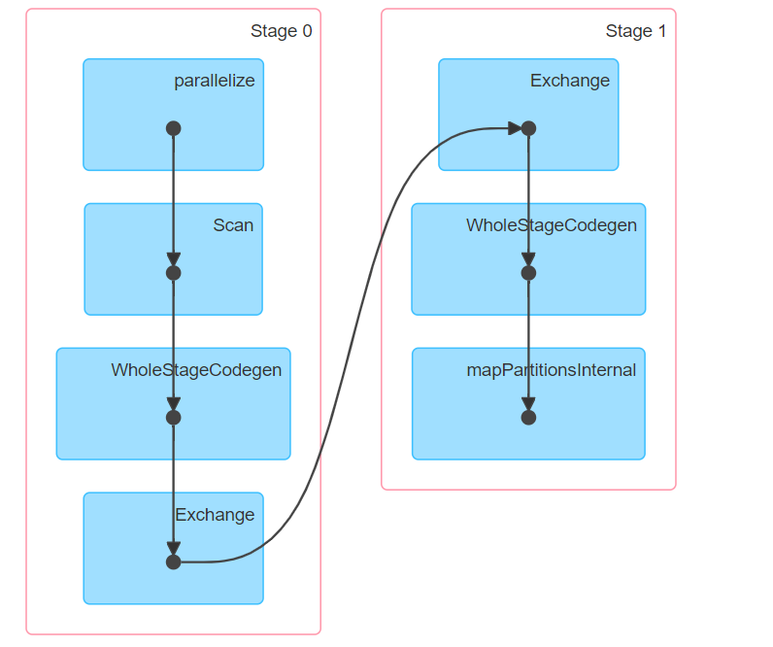

Slide 15
spark.sql.shuffle.partitions

Slide 16
Summary
Next part we will talk about TungstenAggregationIterator

